Slide 1
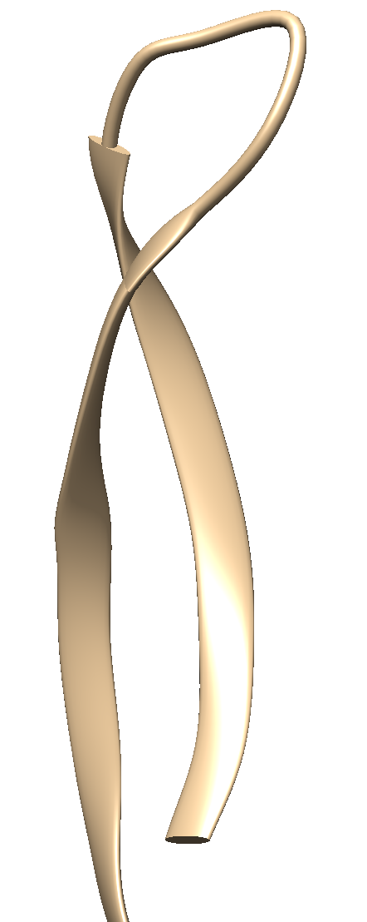
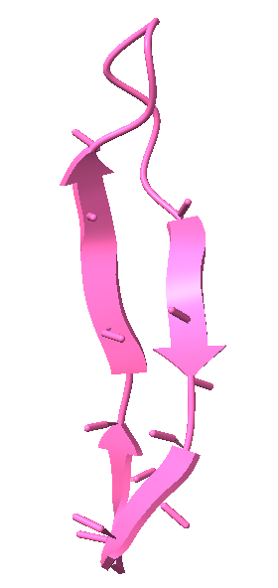
ChimeraX:
The beta strand ends at CA
Chimera:
The beta strand ends at the peptide bond
Non-interrupted beta strands
interrupted beta strands

